Slide 1
RE FX Training
-Mohammed Nasar Ali

Slide 2
AGENDA
Introduction to Real Estate Management
Master data in RE FX
Contract Management
Rental Accounting
Resubmission
Reports

Slide 3
1. Introduction
SAP RE-FX is defined as SAP Flexible Real Estate and is a SAP module that helps in managing Client Real Estate portfolio.
It is fully integrated with the other the modules and functions including Finance with the statutory functions of Management Accounting and Commercial catalogue of Vendors

Slide 4
FUNCTIONALITY
RE-FX has several benefits as follows:
Simplified integration between your financial accounting, controlling, and reporting functions and leasing transactions.
Provides functionality to simplify and organise all the stages of the real estate portfolio life cycle, such as lease-in, lease-out, licences, business rates, and land transactions.
Provides structured and operational support to effectively manage Client’s real estate portfolio.
Online real time integration between RE-FX and Client’s Finance System (SAP Finance Module) such as vendor payments and customer invoices.

Slide 5
2. Master Data in RE-FX
Similar to the data types in SAP, RE-FX also has the concept of Master Data and Transactional Data.
Master data in RE-FX has two sets of objects:
  Architectural objects: Represent the physical view of real estate. In RE-FX these objects together form the Architectural View. Some examples are parking area, enclosed area, floors, building and rooms.
  Usage objects: Represent the financial view of a real estate. In RE-FX these objects together form the Usage View. Some examples are land, building and rental objects.

Slide 6
Architectural View and Objects
Locality
Land/Property
Building
Enclosed Area
Parking Area
Floor
Part of Building
Room
Floor
Parking Area
Part of Land
Enclosed Area
Functional Asset
Room
Architectural Objects forming an Architectural View

Slide 7
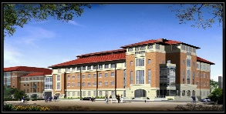




Usage View and Objects
Each business entity is assigned to a company code
Company Code
Business entity is highest element in the usage view
Business Entity
Property/
Land
Building
Building
Car Park
Apartment
Rental Unit
Rental Unit
Lease Contract
Rental Contract
Lease-In or Lease-out
Lease-Out or Lease In
Usage Objects forming a Usage View

Slide 8
Linking between Architectural and Usage View
As the Architectural objects represent physical view and Usage objects represent financial view of the same real estate objects, they are integrated or linked with each other
Architectural View
Usage View
Locality
Business Entity
Land/Property
Building
Land
Building
Enclosed Area
Parking Area
Floor
Part of Building
These floors form one pooled space for office use.
Floor
Floor
Rental Object
(Car Parking)
Rental Object (Office Space)
Floor
Parking Area
Part of Land
Enclosed Area
Functional Asset
The usage for Parking Area is Car Parking.
Linking between Architecture and Usage View

Slide 9
Architectural View and Objects
Section 1 Maintain AO Locality
Section 2 Maintain AO Operational Complex
Section 3 Maintain AO Land
Section 4 Maintain AO Building
Section 5 Maintain AO Parking Area
Transaction code REBDAO to navigate to the Architect Object screen

Slide 10
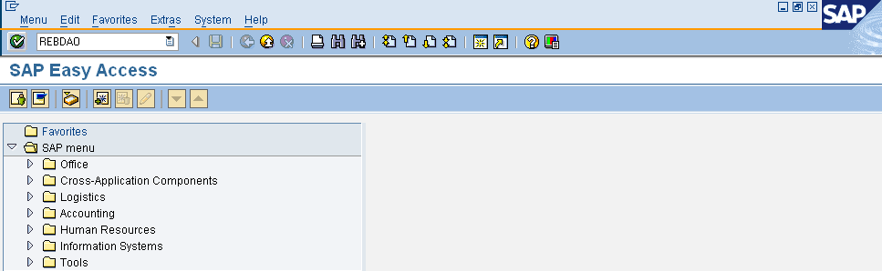
Architectural View and Objects
To create AO Locality:
Access the SAP Easy Access screen
Enter the Transaction code REBDAO to navigate to the Architect Object screen

Slide 11
Usage View and Financial Accounting…
Within the Usage View, Client RE Team will set up all the relevant contracts and will make periodic postings to these contracts
These postings will generate financial transactions in the Finance module creating open items against Customer/Vendor accounts
These open items will be picked up at the time of periodic payment program runs and the payments to vendors and receipts from customers will be processed
The Finance team will do a month-end run of the CO settlement process which will transfer the costs from RE Objects to the respective WBS Elements

Slide 12
Usage View and Financial Accounting…
While creating Usage View Objects, the Client RE Property Services team will provide data to the Client Finance team, to identify Profit Centre and WBS Elements for Usage View Objects
The Finance team will provide the relevant Profit Centre and WBS element to be assigned to the Usage View Objects
WBS Element:
  Refers to Work Breakdown Structure element that describes a project task or a partial task that can be sub-divided
  Is a specific key (Alpha-numeric) maintained in Financial Accounting and is required to be assigned to RE Usage Objects to settle costs

Slide 13
Usage View and Financial Accounting
Profit centre:
  Is an organisational unit in Financial Accounting that displays a management-oriented structure of the Client Organisation for the purpose of internal control
  Is necessary to be assigned to the Usage View objects, as Profit Centre accounting is integrated with the Finance module

Slide 14
Usage View and Objects
Section 1 Maintain Business Entity
Section 2 Maintain Building
Section 3 Maintain Land
Section 4 Maintain Rental Object

Slide 15
Create Business Entity
The creation of a Business Entity in RE-FX is a part of Master data set up and is important for creating subordinate Master data objects like, building, land/property, and rental objects
Every time a new Business Entity is created it is released in SAP so that it can be used for creating further subordinate Master data objects
While creating the Business Entity, the system is checked for any existing Business Entity with the same name
The Business Entity is created with the Business Location number that is maintained in the Client Catalogue system

Slide 16
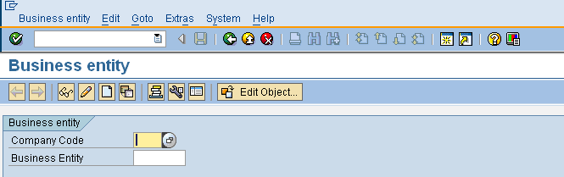
Create Business Entity
To create Business Entity:
Access the SAP Easy Access screen
Enter the Transaction code REBDBE to navigate to the Create Business Entity Object screen
Click Create Object Button
Business entity Screen

Slide 17
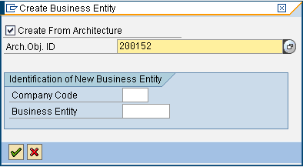
Create Business Entity
In the Create Business Entity screen, select the Create From Architecture option to link the Business Entity to the relevant Architectural Object (Locality)
In the Arch. Obj. ID field, enter the Architecture Object ID under which you want to create the Business Entity
Create Business Entity Screen

Slide 18
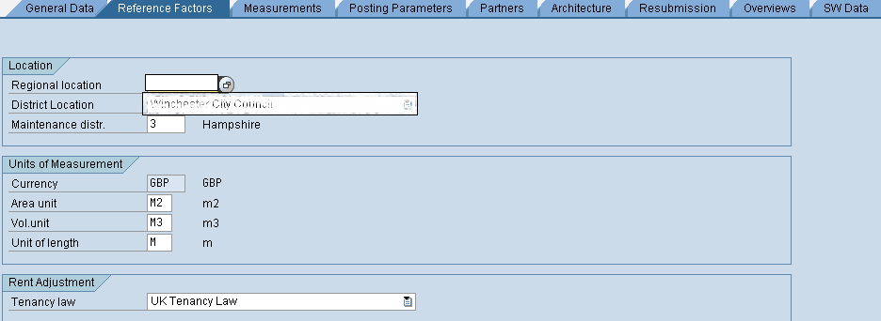
Create Business Entity
In the Reference Factors tab page, enter the Regional Location under which you want to create the Business Entity
The values in Units of Measurement and Rent Adjustment sections are displayed, by default
Reference Factors Tab page

Slide 19
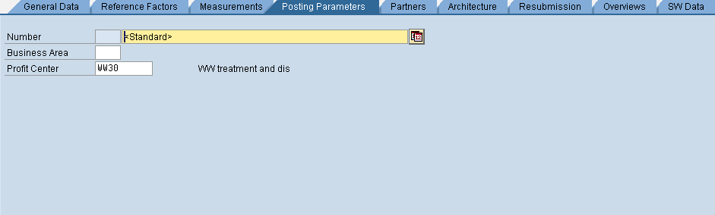
Assign Profit Centre to Business Entity
Before the Property Services team starts processing the Business Entity, the team will receive the relevant profit centre and WBS Element number from the Client Finance team for this site
In the Posting Parameters tab page, enter the Profit Centre number in the Profit Centre field
Posting Parameters Tab page

Slide 20
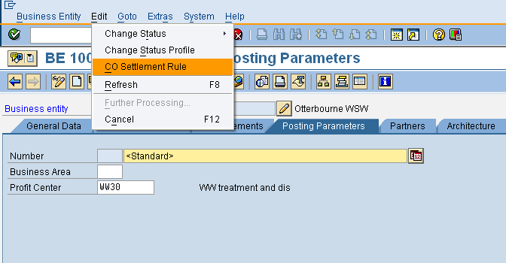
Assign WBS Element number to Business Entity
Select the CO Settlement Rule option from the Edit menu to assign a WBS element to the Business Entity

Slide 21
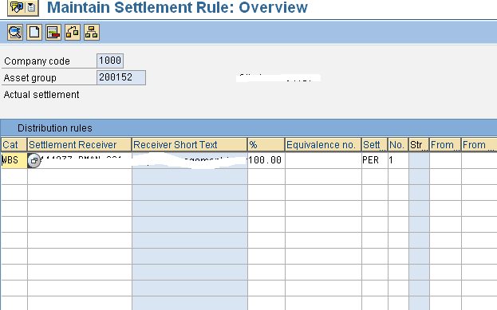
Assign WBS Element number to Business Entity
Enter the Category as WBS and select the Settlement Receiver
Maintain settlement Rule page

Slide 22
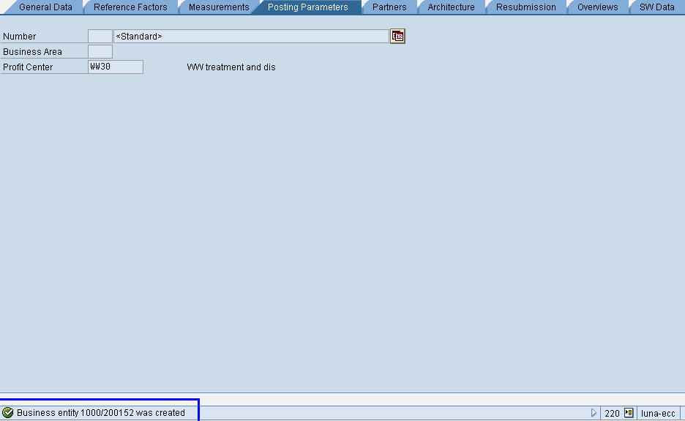
Create Business Entity
Check for errors and Save the entered Business Entity. A message is displayed confirming that the Business Entity is created.
Posting Parameters Tab page

Slide 23
Create Building
The creation of Building in RE-FX is part of the Master data set up and is important for creating subordinate rental objects like, rooms, apartments, warehouses, stores
Every time a new Building is created, it is referenced to the Business Entity it belongs to
While creating the Building, the system checks for any existing Building with the same name
Once the Building is created, the Building number assigned to it is same as the Site Unit number maintained in the catalogue system
After creating a Building, it is released in the system so that it can be used for creating further subordinate rental objects
Transaction code REBDBU to navigate to the Create Building Object screen

Slide 24
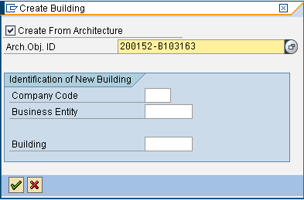
Create Building
In the Create Building screen, select the Create From Architecture option to link Building to the relevant Architectural Object (AO Building)
In the Arch. Obj. ID field, enter the Architecture Object ID under which you want to create Building
Create Building Screen

Slide 25
Create Land
The creation of Land in RE-FX is part of the Master data set up and is important for creating subordinate rental objects like, parking spaces, and open garage spaces
Every time a new Land is created it is referenced to the Business Entity it belongs to
Once a new Land is created it will be released in SAP so that it can be used for creating further subordinate rental objects
While creating the Land, the system checks for any existing Land with the same name
Once the Land is created the Land number assigned to it will be the same as the Site Unit number maintained in the catalogue system
Transaction code REBDPR to navigate to the Create Land Object screen

Slide 26
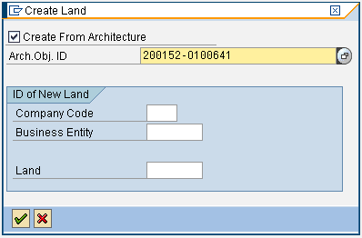
Create Land
In the Create Land screen, select the Create From Architecture option to link Land to the relevant Architectural Object (AO Land)
In the Arch. Obj. ID field, enter the Architecture Object ID under which you want to create Land
Create Land Screen

Slide 27
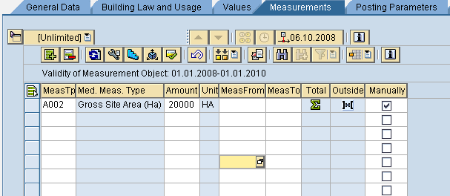
Create Land
In the Measurement Tab page, enter the Measurement Type and Amount
Click Add Measurements to add measurements of Land
Measurement Tab page

Slide 28
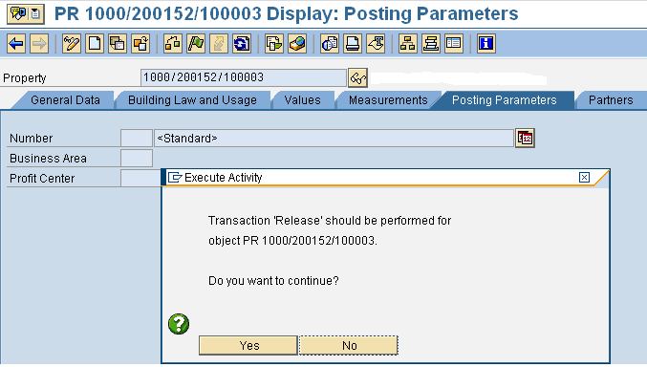
Create Land
Click the Release button to release Land for postings
Release button
Click Yes button to confirm the release of Land for postings
Posting Parameters Tab page

Slide 29
Rental Objects
The Rental Objects are significant objects in RE-FX implementation. They are used throughout the management of RE Assets, and are organised with attributes that connect the Rental Objects with other RE-FX objects
A Rental Object is created to provide RE-FX objects that can be accounted by the assignment of contracts, periods of usage, and management of tenancies
Following are the conditions that initiate the creation of Rental Objects:
  When a new Business Entity is created with creation of Building or Land master record
  When a new Building or Land master is created in an existing Business Entity
  When an existing Building or Land master is changed
Transaction code REBDRO to navigate to the Create Rental Object screen

Slide 30
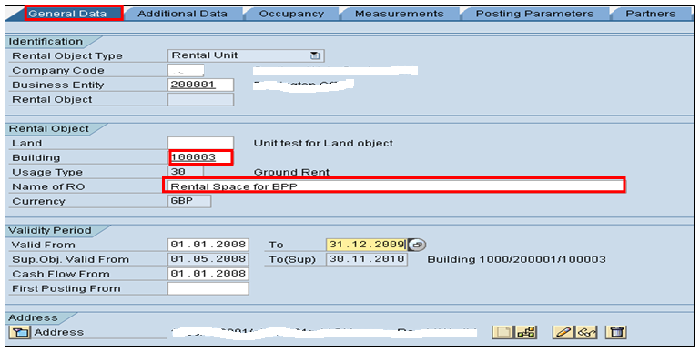
Create Rental Unit
In the General Data tab page, enter the Building number to which the Rental Unit belong to, Name, and Address of the Rental Unit
General Data Tab page

Slide 31
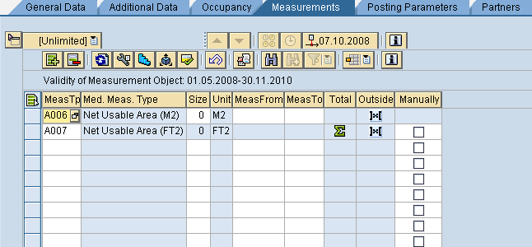
Create Rental Unit
Enter the Measurement Type and Unit in the Measurement Tab page
Click Add Measurements to add measurements of the Rental Unit
Measurement Tab page

Slide 32
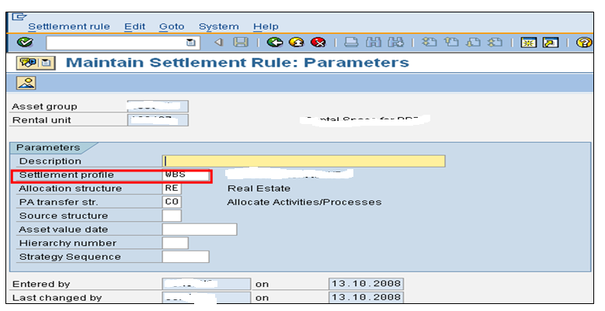
Assign WBS Element number to Rental Unit
Enter the Settlement Profile as WBS and press ENTER
Maintain settlement Rule page

Slide 33
Create Pooled Space
Pooled space is created whenever Client has a rental object that is used by more than one customer and can either be a part of a Building or Land
Pooled space is created as a flexible space which can be split again, based on the requirement for each customer, while leasing out the rental object
There will be no pooled spaces created in the existing ECC system at go live. However, pooled spaces will be created for office space occupied by contractors and maintained post go-live.
Transaction code REBDRO to navigate to the Create Rental object screen

Slide 34
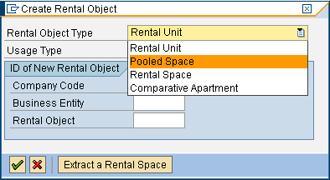
Create Pooled Space
In the Create Rental Object screen, select the Rental Object type as Pooled Space
Create Rental Object Screen

Slide 35
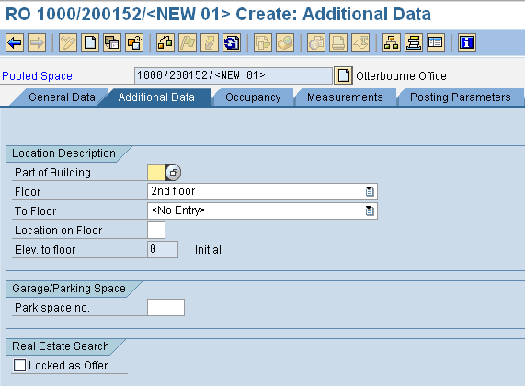
Create Pooled Space
Enter the Floor number to which the Pooled Space belongs to in the Additional Data tab page
Additional Data Tab page

Slide 36
Extract Rental Space from Pooled Space
Rental Space is a flexible space derived or extracted from the Pooled Space
The prerequisite for creating a rental space is a valid pooled space with the same usage type of the rental space that is required – for example, if you want to create a rental space for office there must be a pooled space created with the same usage type of office
Rental space can be created independently just like a rental unit, and later it can be assigned to a contract while that contract is being created
Rental space can also be created while creating a contract by extracting Rental Space from the available pooled space
Transaction code REBDRO to navigate to the Create Rental Object screen

Slide 37
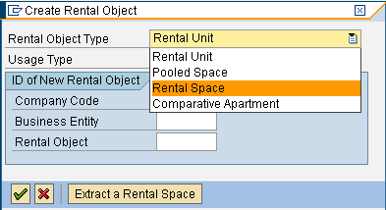
Create Rental Space
Rental Unit is displayed by default in the Rental Object Type screen. Choose the Rental Space option from the Rental Object Type drop-down list.
Create Rental Object Screen

Slide 38
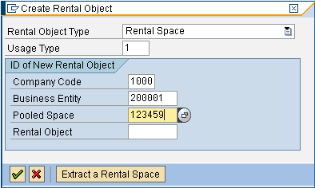
Create Rental Space
In the Create Rental Object screen, enter the Usage Type of the Rental Space, Company Code under which you want to create a Rental Space, Business Entity to which the Rental Space belong to, and the Pooled Space from which the Rental Space is to be created
Create Rental Object Screen

Slide 39
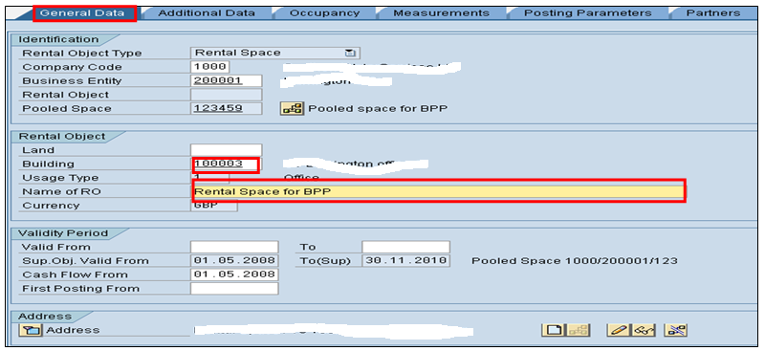
Create Rental Space
In the General Data tab page, enter the Name of the Rental Space, the Building/Land number to which the Pooled Space belongs to, the Address of Rental Space is displayed by default
General Data Tab page

Slide 40
Business Partner
Every time Client interacts with a new person/enquiry (customer/vendor) regarding a real estate requirement, the Client RE team will create the business partner as a person in the system
Business partner in SAP RE-FX is someone with whom Client has a business relationship related to Property Services
Business partner is classified as a:
  Person
  Organization (Company, Industry)
  Group (Associations, Boards)
The above categories are pre-defined in SAP and must be always specified before creating a business partner

Slide 41
Business Partner Role
The business partner can have various roles based on the business transactions being performed such as, lease-in, lease-out, service contract
When a new business role is created for a business partner, the business partner also acquires additional attributes and data based on the business transaction.

Slide 42

Business Partner Roles
Service Provider
Landlord with Vendor account
Role
Tenant with Customer account
Role
Role
Rating Authority with Vendor account
Role
Role
Solicitor
Contact Person
(Business Partner)
Note: When a business partner is created, the default business partner category assigned is ‘person’ and the default role is ‘contact person’.
A business partner (default category: person) can perform various business roles based on the business transactions.

Slide 43
Types of Business Partners
Business partners are of three types, depending on their integration
with Finance:
Customer-based
Vendor-based
Non-financial
Customer-based business partners are companies, persons or organisations that Client Property Services will be invoicing for rent or other real estate related products and services. These business partners are created by the system automatically, when new customers are created in SAP Finance. Examples are, tenants and licensees.

Slide 44
Types of Business Partners
Vendor-based business partners are those, to whom Client Property Services will be paying for real estate related products, services and business rates. The business partner records are created and updated automatically, whenever finance vendor records are maintained. Examples are landlords, licensors and rating authorities.
Non-financial business partners are related to Property Services, but have no financial transactions with Client. The business partner records are solely maintained by Property Services. Examples are, contact person or agencies who deal on behalf of tenants and landlords for collection of rents.

Slide 45
Creating Business Partner
Before creating a business partner in RE-FX, Client Property Services team will decide whether this Business Partner is Financial or Non-Financial
If the Business Partner required is financial, Property Services team will provide FI/P2P team with an agreed checklist that contains information about customer/vendor
FI/P2P team will then create a customer/vendor and provide Property Services with its number in the SAP system
Property Services team will check if a customer/vendor has necessary BP roles assigned to it before using them on contracts
Note: The customer/vendor master is controlled by FI/P2P and
should “NOT” be altered by Property Services team

Slide 46
Creating Business Partner
Creation of business partners with a vendor or customer account is mandatory for real estate module as the customer master/vendor master cannot be assigned directly on real estate contracts
Client Property Services team will also create generic or non-financial business partners on RE Master data objects (Site, Buildings, Land, Rental Objects, and RE contracts) for information purposes. These non-financial business partner will not have a customer or vendor account linked to them
The non-financial business partner would be created whenever Property Services has a new enquiry for a lease out process

Slide 47
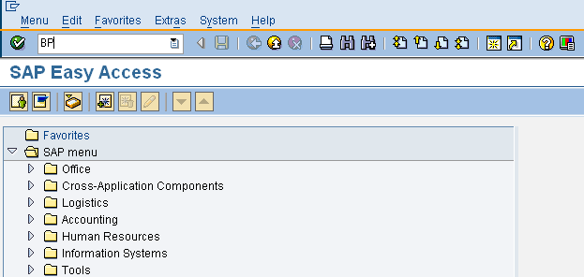
Create Non-Financial Business Partner
To create Non-Financial Business Partner:
Access the SAP Easy Access screen
Enter the Transaction code BP to navigate to the Create Business Partner screen
SAP Easy Access Screen

Slide 48
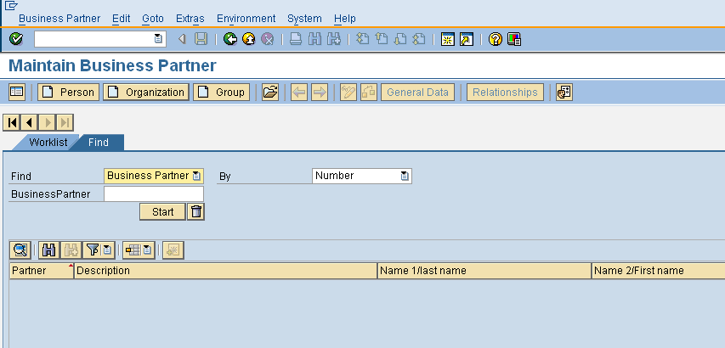
Create Non-Financial Business Partner
In the Maintain Business Partner screen, click Organization to specify the category as Organisation in which you wish to create the Business Partner
Click Organization
Maintain Business Partner Screen

Slide 49
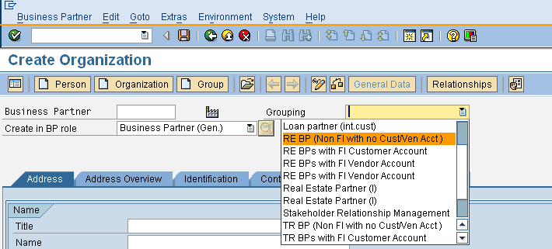
Create Non-Financial Business Partner
Click Grouping and select the grouping in which you want to create the Business Partner
Create Organization Screen

Slide 50
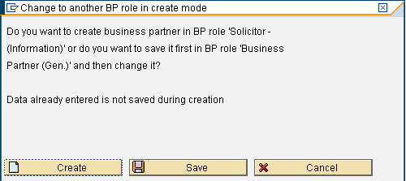
Create Non-Financial Business Partner
Click Create button to create Business Partner

Slide 51
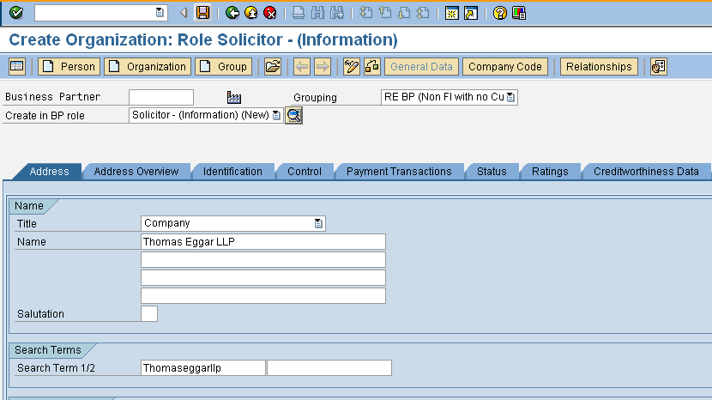
Create Non-Financial Business Partner
In the Address tab, enter the required data for Business Partner, such as Name, Address, Contact number and click Save
Address Tab page

Slide 52
3. Contract Management
What is the RE-FX Contract?
The RE-FX Contract defines financial obligations between Client and landlords, tenants, rating authorities, and other real estate related business partners
The contract also defines the parties, the terms, objects to be rented or contracted, posting parameters, rental conditions, and other special details for processes, such as reminders, and overviews

Slide 53
Contract Creation and Activation
Why RE-FX Contracts?
RE Contract Creation has several benefits such as:
Standardisation of contracts into specialised groups of contracts
Faster contract creation using the master data available in the system
Easy diary maintenance with specific reminder dates

Slide 54
Contract Creation and
Activation Process
Role
Process Flow
Obtain Profit Centre and WBS Element from Finance team
Check RE Master Data required in Usage View
Create Contract with conditions/partner
Property Services Team
Activate Contract
Make Periodic Payment for contract
Finance team
Process Vendor/Customer Open Items

Slide 55
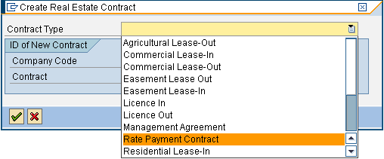
Contract Creation and Activation…
The RE team member will click Create and select the required contract type in the following screen through Transaction code RECN.
Select the contract type

Slide 56
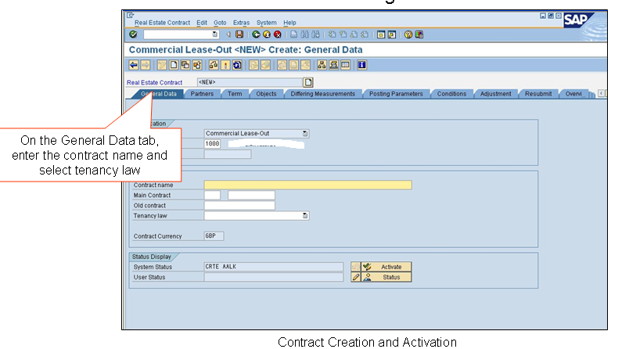
…Contract Creation and Activation
The RE team member will use the following screen to enter the contract details.
Contract Creation and Activation

Slide 57
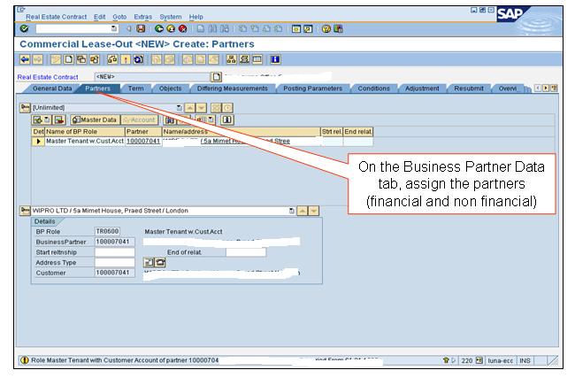
…Contract Creation and Activation
In the Partners tab, select business partner

Slide 58
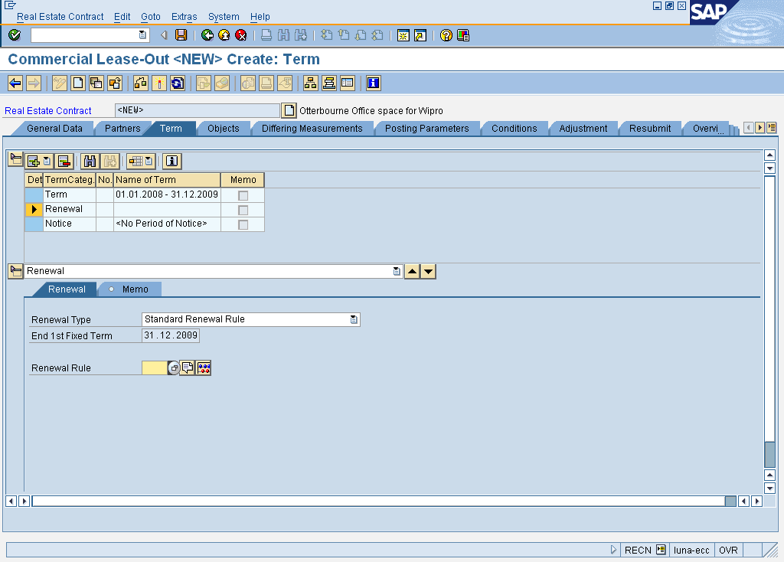
…Contract Creation and Activation
On the Term tab, enter the contract period, assign the renewal and notice rule

Slide 59
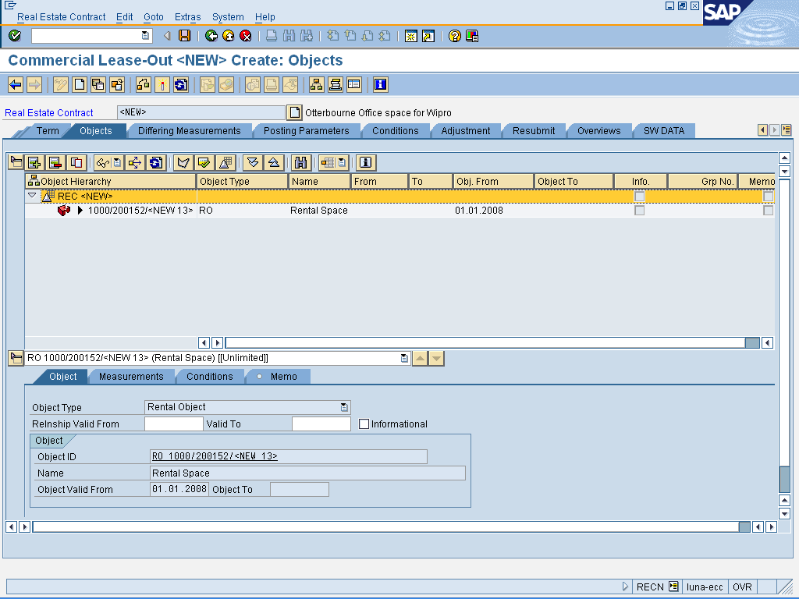
…Contract Creation and Activation
On the Objects tab, assign the rental object to the contract

Slide 60
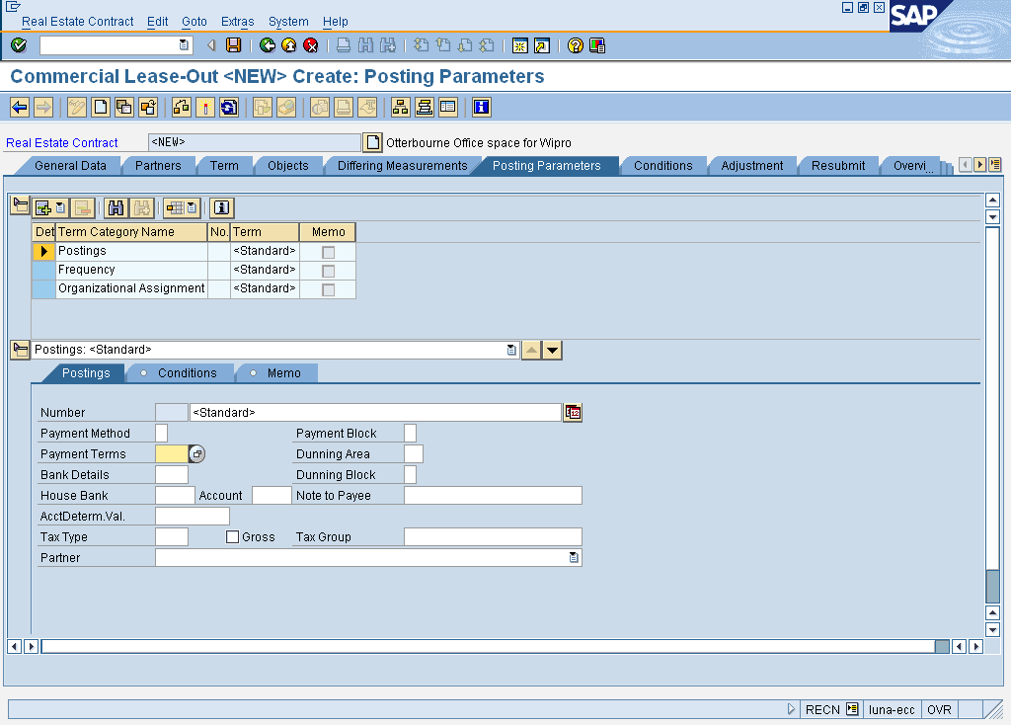
…Contract Creation and Activation
In the Posting Parameters tab, enter the payment details, frequency, tax group, profit center, etc.

Slide 61
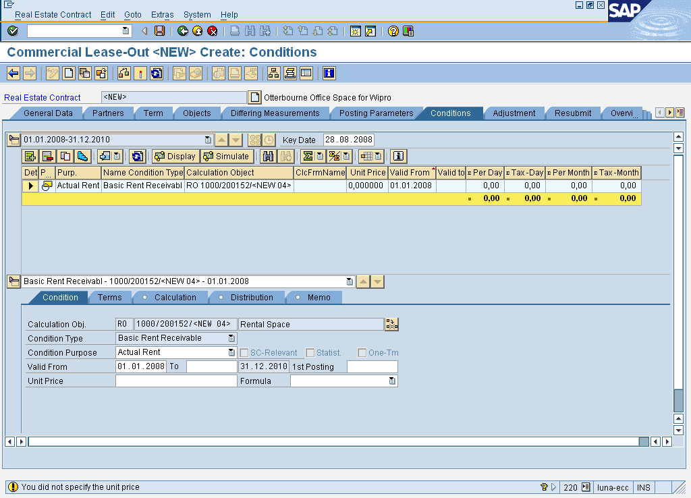
…Contract Creation and Activation
On the Conditions tab, enter the condition amount, valid from and to date and the formula

Slide 62
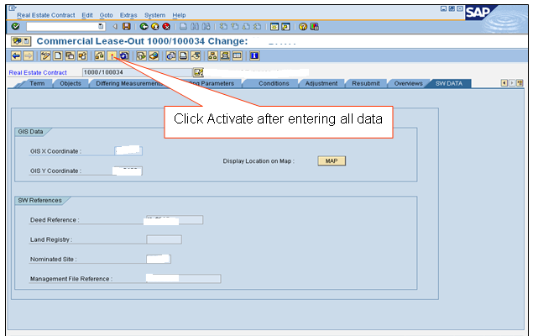
…Contract Creation and Activation
In the Client DATA tab, enter the Client specific data and then click activate and save

Slide 63
Notice Process
Role
Process Flow
Maintain a Notice Rule on contract
Monitor Key Dates
Record or Give Notice
RE Team Member
Approve/Reject notice
Notice Activated
RE Team Manager

Slide 64
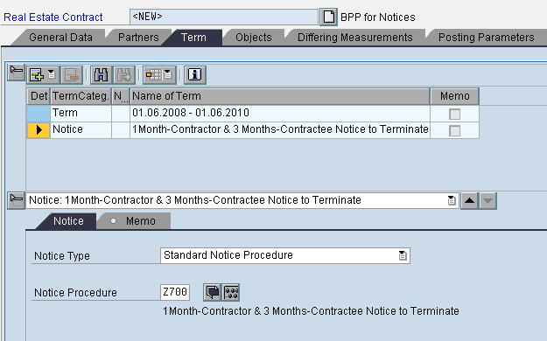
Assign/Edit Notice Rule
The notice rule assigned to a contract can be viewed and changed from the following screen
Notice Rule
Notice Type
Notice Rule

Slide 65
Renewals
Renewal requires typically notice, discussion, agreement, acceptance, and the sending or exchanging of the offer or amended contract with reference to the original contract
Contract renewal can be initiated by the standard resubmission process, followed by the correspondence of a legal contract with new terms, conditions and special terms
Some contracts will permit renewals for terms of years, based upon tenant acceptance of an upward amount based on proposal of the landlord or acceptance of a formulated rent in the original contract (i.e., 10% increase, increase equal to the RPI difference, or a set amount)

Slide 66
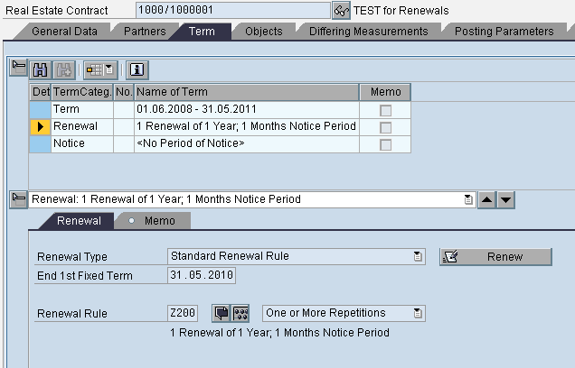
Edit Renewal Rule
The renewal rule assigned to a contract can be viewed and changed from the following screen.
Renewal Rule
Notice Rule

Slide 67
Standard Reports
The RE team members can generate reports on an ad-hoc basis.
Based on the data available in the contracts, the following standard
reports can be generated.
Term - REISCNPE
Renewal of Contract - REISCNRN

Slide 68
4. Rental Accounting
RE-FX uses SAP Financial Accounting module for handling accounting processes
Each tenant is a customer and each landlord is a vendor. There is a 1:1 relationship between the master tenant with the customer account in the business partner management and a customer in the Financial Accounting. The landlord with vendor account and a vendor will also have a similar relationship
The Accounts Receivable and Accounts Payable components are used to manage open items in Finance (FI). If there are multiple contracts for one customer or vendor, then all the contracts are managed using the same customer or vendor account
Since Profit Centre Accounting is activated in FI, it becomes mandatory for RE-FX team to assign Profit Centres on usage view objects

Slide 69
…Rental Accounting Overview
Financial Accounting
RE-FX
Financial
Accounting
Accounting
Vendor Account
Payable
Landlord
Customer Account
Receivable
Tenant
One to one relation between RE-FX and Financial accounting

Slide 70
Periodic Postings
Period postings are performed for Real Estate contracts to post the accounting flows resulting from the conditions in the contract
Periodic Postings will generate open items for customer/vendor accounts
These open items are cleared using incoming or outgoing payments or through Account Management procedures
Periodic Postings are done on the basis of following posting parameters/terms defined during the contract creation process
  Frequency of posting (monthly, quarterly, yearly)
  Organisational assignment (Profit centre)
  Payment terms, tax codes, business partners

Slide 71
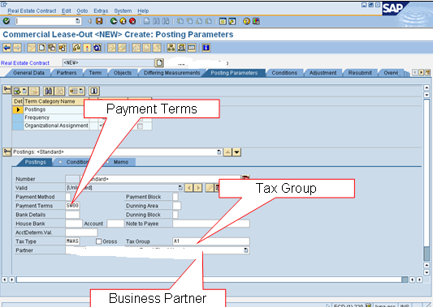
Posting Parameters…
The RE team member enters the payment details in the Posting tab

Slide 72
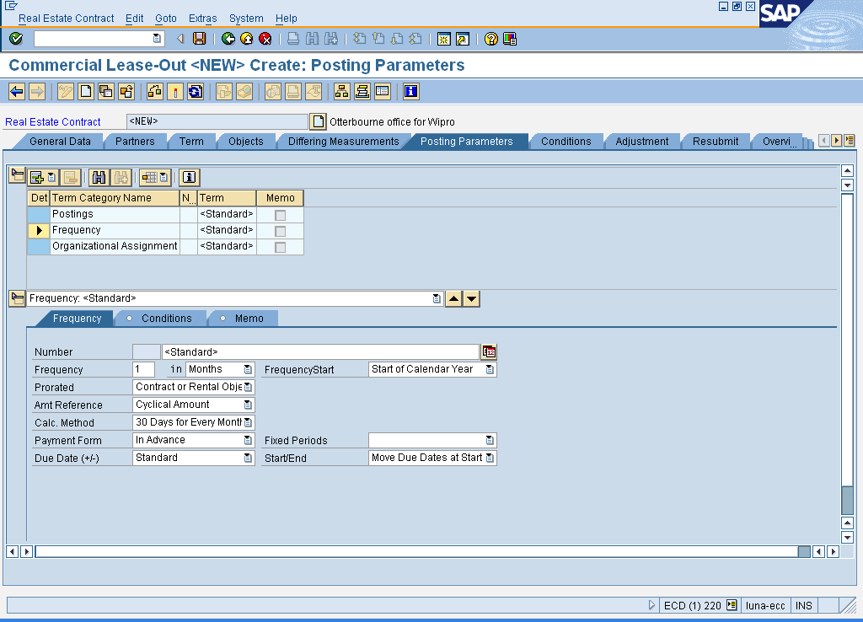
…Posting Parameters
The RE team member will update the Frequency details as per the contract
Frequency
Select if English Quarter days only
Payment Form
Frequency Tab

Slide 73
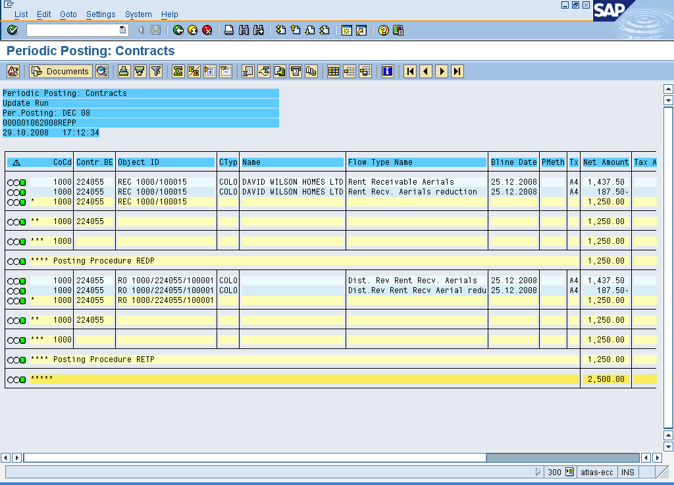
…Periodic Postings
Transaction code is RERAPP - Periodic Posting: Contracts
The Process ID is generated for every periodic posting run
Process ID
Periodic Posting

Slide 74
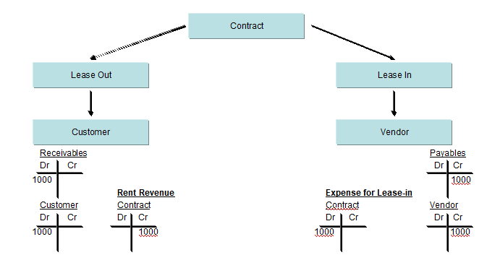
Periodic Posting: Accounting

Slide 75
Reverse Periodic Postings
When a reversal of Periodic Posting is carried out in RE-FX, the financial documents are reversed and updated in financial accounting in real time
The reversal of periodic postings affects the cash flow and reverts the actual positions to planned positions
Documents that are generated from RE-FX can only be reversed from RE-FX component
It is not necessary to reverse periodic posting whenever an RE team member makes changes to the conditions after the periodic posting run, because these changes are considered in the next periodic run
While performing reversal of periodic postings, the RE team member will enter the process ID for periodic posting or choose the contract number for which the reversal is being done
The RE team member will also enter a reason for reversal of periodic posting

Slide 76
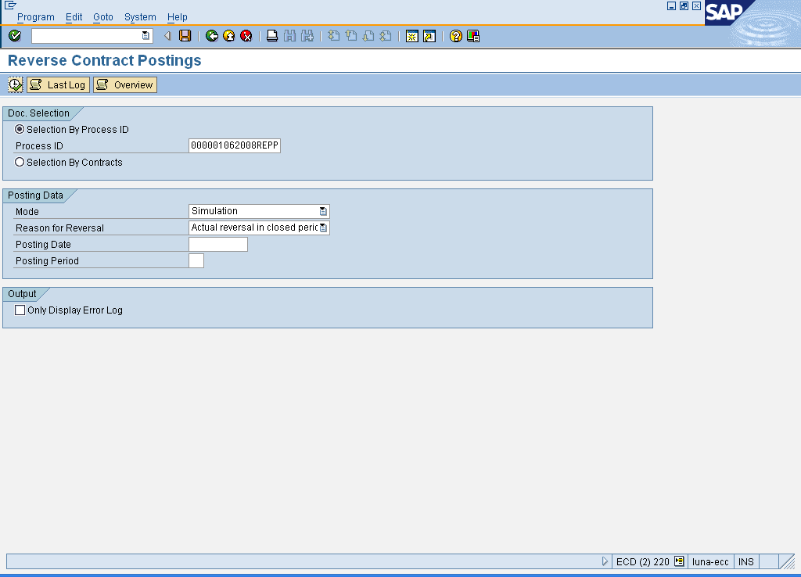
Reverse Periodic Posting
RERAPPRV - Reversal of Periodic Posting for Contracts
The RE team member will use the following screen to reverse periodic posting
Process ID
Reason for Reversal
Reverse Periodic Posting

Slide 77
5. Resubmission
Resubmission is a function that allows Client Property team to set reminders in the system that may be required for Client RE contracts in particular but also any master data
It helps manage dates, warn of critical future dates, and detect or display what dates will be significant in the immediate and more distant future for an RE contract or master data
Resubmissions are defined by assigning Resubmission rules to RE contracts or master data
Resubmission provides date intervals to determine if follow-up action is required for any of the contracts or master data in the RE system

Slide 78
Why Resubmission?
The Resubmission process helps Client Property Services team to:
Regularly review monthly processing of future workload that needs to be planned
Ensure that new leases and new adjustments are implemented properly for the benefit of Client cash flow
Manage reminders, notices, or renewal notices, which are indicated in the Resubmission process
Initiate steps to provide legal notice, start renewal negotiation, or produce rental invoices in a timely manner
Identify any requirements for reminders on any of the RE master objects

Slide 79
Resubmission and RE Objects
The Client RE team can define the Resubmission reasons and rules for the following RE objects:
  Architectural Object
  Business Entity
  Property or land
  Buildings
  Rental objects
  Real Estate contracts
The Resubmission rules and reasons can be defined during the creation of a contract, or while creating an RE master data object
These reasons and rules will be pre-configured in the system at the time of Go-Live

Slide 80
Enter Resubmission
To enter the Resubmission for an RE object access Accounting → Flexible Real Estate Management → Master Data → Information System →Resubmission Dates
Alternatively, use the transaction code RECARS

Slide 81
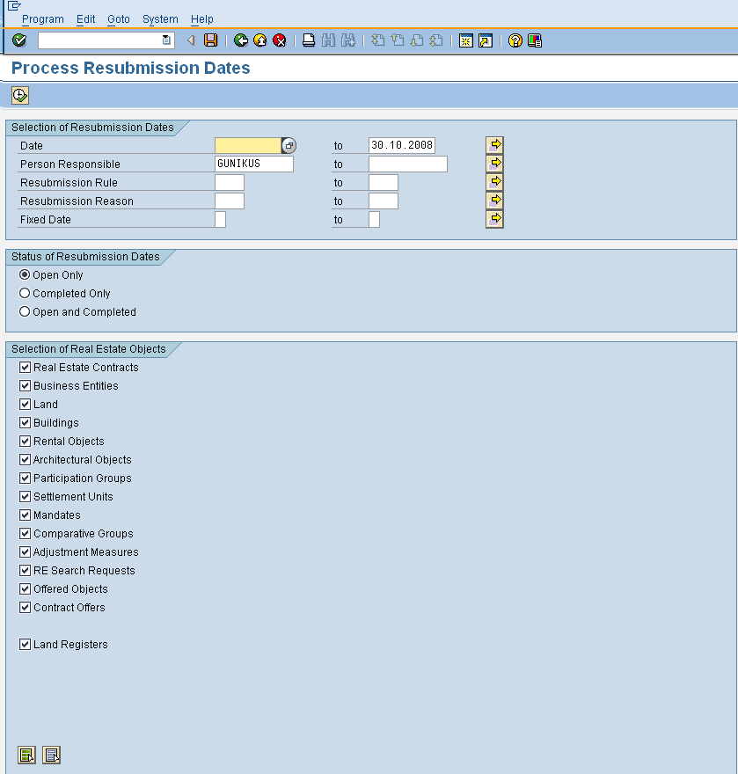
Enter Resubmission
Under the Selection of Resubmission Dates tab, enter the start Date and end date for Resubmission
Under the Status of Resubmission Dates tab, choose the Open Only status
Note: The Client RE team can also choose the other options such as Completed Only, or Open and Completed for information purpose

Slide 82
Enter Resubmission
After the Resubmission status option is selected, choose the Real Estate Objects for which the reminder dates should be generated
Then click Execute to view the Resubmission dates for the selected objects

Slide 83
6. Reports
    Architectural Objects (REISAO)
    Business Entities (REISBE)
    Land (REISPR)
    Building (REISBU)
    Rental Object (REISRO)

Slide 84
Architectural Objects Report
The Architectural Object Report gives an overview of the architectural objects in the architectural view
The Client RE team will enter the relevant details to the Architectural Object before executing this report, for example Information like AO ID and the object validity
To view the Architectural Objects Report access, Accounting → Flexible Real Estate Management → Master Data → Information System →Architectural Objects
Alternatively, use the transaction code REISAO

Slide 85
Business Entities Report
The Business Entity report gives an overview of Business Entity in the usage view
The Client RE team will enter the relevant details to the Business Entity before executing this report, for example company code, number of site and object validity
To view the Architectural Objects Report access, Accounting → Flexible Real Estate Management → Master Data → Information System →Business Entities
Alternatively, use the transaction code REISBE

Slide 86
Land Report
The Land Report displays the following details:
  Company Code
  Business Entity
  Site number
  Land name and number
  City, Street, House number, and Postal code
  Valid from and to dates
To view the Land Report access, Accounting → Flexible Real Estate Management → Master Data → Information System →Land
Alternatively, use the transaction code REISPR

Slide 87
Buildings Report
The Buildings Report displays the following details:
  Company Code
  Site name
  Building name and number
  City, street, house number, and Postal code
  Valid from and to dates
To view the Buildings Report access, Accounting → Flexible Real Estate Management → Master Data → Information System →Buildings
Alternatively, use the transaction code REISBU

Slide 88
Rental Objects Report
The Rental Objects Report displays the following details:
  Company Code
  Site, Land, Building, Rental Object and Rental Space number
  Rental Object name
  City, Street, House number, and Postal code
  Usage types of RO
To view the Rental Objects Report access, Accounting → Flexible Real Estate Management → Master Data → Information System →Rental Objects
Alternatively, use the transaction code REISRO

Slide 89
Master Data Correspondences
The Client RE team can create master data forms for different Architectural objects and Usage objects (including a contract)
These forms will be used as correspondence components by the Client Property Services team in order to create documents (in letter, email, fax format) and send them to the business partners or internally
  Master Data Summary for contract (T-code: RECPA420, or access Accounting → Flexible Real Estate Management → Correspondence → Contract →Master Data Summary)
  Contract Form (T-code: RECPA410, or access Accounting → Flexible Real Estate Management → Correspondence → Contract →Contract Form)
To print/preview the Master Data Summary Sheet for Architectural objects access, Accounting → Flexible Real Estate Management → Correspondence → Master Data →Master Data Summary (AO)
Alternatively, use the transaction code RECPA110

Slide 90
Master Data Summary Sheets
  Master Data Summary for Business Entity (T-code: RECPA130)
  Master Data Summary for Land (T-code: RECPA150)
  Master Data Summary for Building (T-code: RECPA170)
  Master Data Summary for Rental Objects (T-code: RECPA190)

Slide 91
Q and A
Notes:
Confidential © 2008 Wipro Ltd

Slide 92

Notes:
Confidential © 2008 Wipro Ltd

